Slide 1
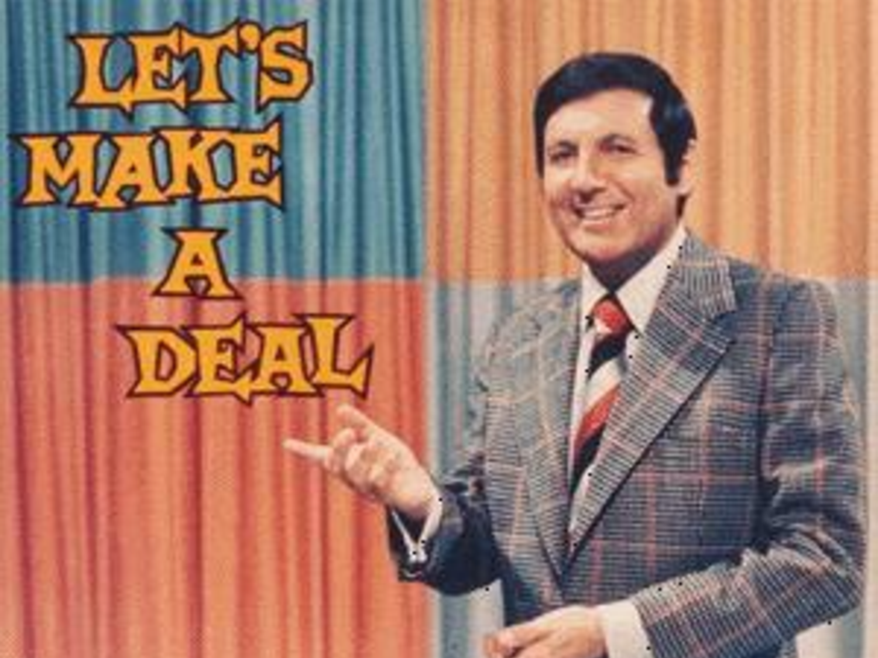
The Monty Hall Problem
PSY 364
Notes:
How many of you have heard of the Monty Hall problem?
Okay, so today, we are going to spend all of class talking about the Monty Hall problem and how to solve it.

Slide 2
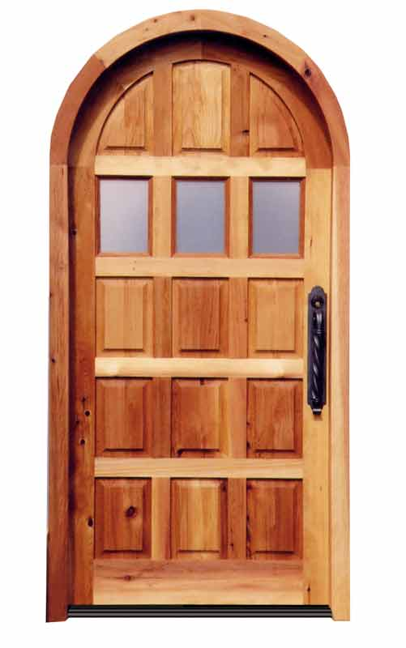
Let’s Make a Deal…
1
2
3

Slide 3
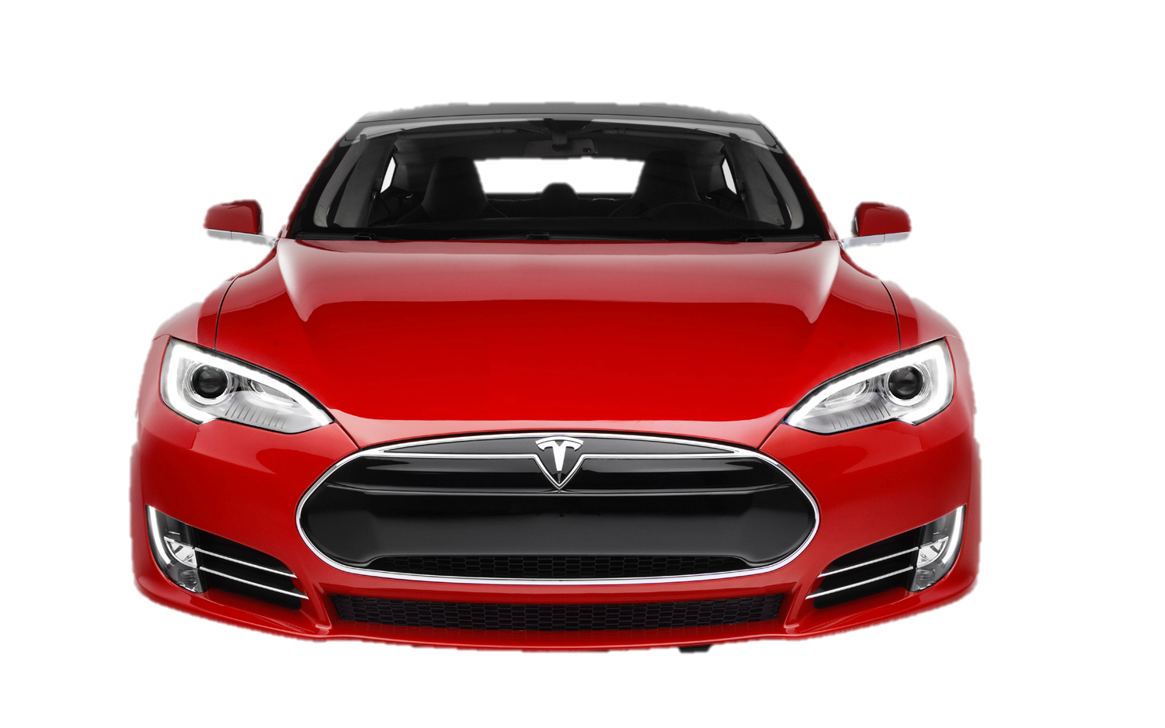
Behind one door…

Slide 4
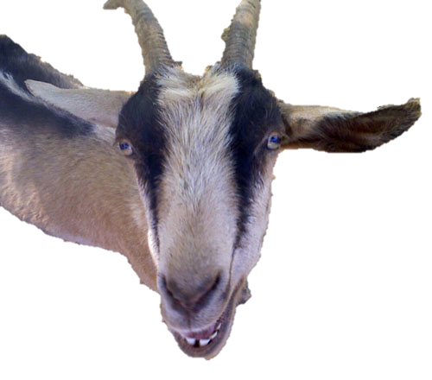
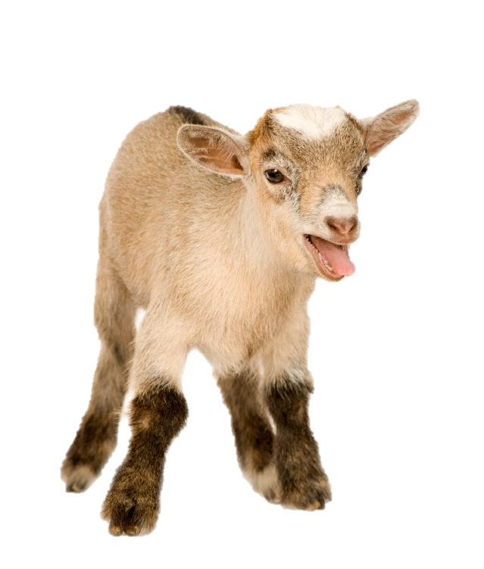
Behind the other two doors…

Slide 5
So which door do you choose?
1
2
3

Slide 6
So which door do you choose?
1
2
3
Notes:
Let’s pretend you chose Door #1. Before you are allowed to see what is behind your chosen door, though, the host opens one of the other doors. So let’s say he opens Door 2 and you find out that there is a goat behind it. So you start to feel very good about your choice. But now the host gives you an option.

Slide 7
Stay or Swap?
1
3
Notes:
Do you want to stay with your original choice, or do you want to swap doors? What do you guys think gives you the greatest chance of winning the car? Do you think you should stay, swap, or that it doesn’t really matter, the probability is the same? How many say stay? How many say swap? How many think that the probability is the same either way?

Slide 8
Activity
Log in to Blackboard Learn
Navigate to Unit 4
Choose “Monty Hall Problem Interactive Program” at the bottom of the page

Slide 9
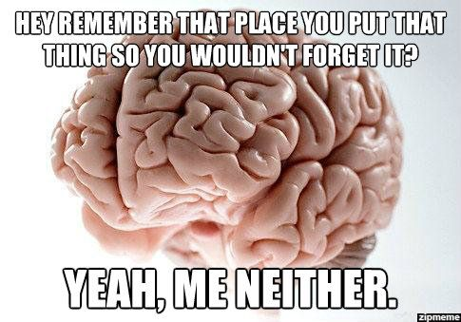
The Answer is Counterintuitive
Intuition doesn’t always lead you in the right direction
Important to consider true probability instead of relying on instinct.
Your brain is not perfect.
The correct answer is: ALWAYS SWAP
Notes:
I kind of figured that most of you would say it doesn’t matter either way. You’re not really suckers. I think almost every single person, unless they have heard this problem before, would say that it doesn’t matter. It makes intuitive sense, right? There are two doors, so there is a 50/50 chance you will get a car. This sounds perfectly reasonable, and intuitive. However, your intuition doesn’t always lead you in the right direction. It’s important to actually do the math and consider the true probability rather than relying on instinct, because in this case, your instinct is wrong. Obviously, your brain is not perfect. There is a correct answer to this, and it is YOU ALWAYS SWAP. This actually gives twice the chance of winning the car. This seems really weird, but I am going to explain why, so from now on, if you ever go on Let’s Make a Deal or someone asks you about the Monty Hall problem, you can show off how smart you are.

Slide 10
Let’s look at the probability…
When you first pick a door,
1 car behind the 3 doors
1
3
33% of choosing the car as your first choice
=
=
2 goats behind the 3 doors
2
3
66% of choosing a goat as your first choice
=
=
Notes:
So let’s think about this logically. When you first choose a door, there is one car and two goats. So you have a 33% chance of choosing the car on your first time and a 66% chance of choosing a goat.

Slide 11
If you STAY
It doesn’t matter which goat door the host opens, you still have a
33% chance of having chosen the car
66% chance of having chosen a goat
Notes:
If you plan on sticking with your first choice, it doesn’t matter which goat door the host opens. You will be sticking with your first choice, which means there is a 33% chance you’ve already picked the car and a 66% chance you’ve already picked a goat. Although it seems like once the host opens a goat door, your chance of having the car increases to 50%, this is not the case. The reason for this is because the host KNOWS what is behind each door. He will open a goat door no matter what. He will never open the door with the car, because he wants to make you feel like your chance of winning is higher than it is. The only way you would have a 50/50 chance is if you chose a door for the first time AFTER the host revealed one goat, because then you would only have a choice between two things, a goat and a car. Does this make sense still? Is anyone confused? Does anyone not get this?

Slide 12
If you SWITCH
Remember, you have a 33% chance of having chosen the car during the first round.
This means that if you swap, you will end up with a goat. In other words, 33% of the times that you swap, you will end up with a goat.
Notes:
Now let’s look at the probability if you switch. Remember, you have a 33% chance of choosing the car the first time. This means that, after the host reveals what’s behind one of the other doors, and you swap, you will get a goat. Right? So if you swap, you have a 33% chance of ending up with a goat.

Slide 13
If you SWITCH
If you picked a goat the first time (a 66% chance) the host will only have one other goat to reveal. This means that every time you pick a goat first, if you swap, you will get the car.
In other words, if you swap, you have a 66% chance of winning the car.
Notes:
However, if you chose a goat the first time (which is much more likely), the host will only have one other goat door to reveal. This is the most important part of this problem, because it means that EVERY TIME you pick a goat first and you swap, you will get the car. So if you swap doors, you have a 66% chance of winning the car. Does this make sense? Does anyone NOT get it?

Slide 14
In Sum,
If you stay…
If you switch
33% chance of winning a car
66% chance of winning a goat
66% chance of winning a car
33% chance of winning a goat

